Slide 1
St Patrick’s College, Maynooth, Ireland
A Warm Welcome Awaits
Societas Liturgica 2023

Slide 2
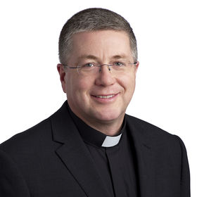
A WORD FROM THE PRESIDENT OF
ST PATRICK’S COLLEGE, MAYNOOTH
On behalf of the Pontifical University and the wider community at St Patrick’s College, Maynooth, I am delighted to support this bid to bring the 2023 Congress of Societas Liturgica to Ireland.
St Patrick’s prides itself on a long tradition of welcome and hospitality. Our beautiful and vibrant campus has a treasured reputation as a venue for academic conferences, religious assemblies, retreats
and summer schools. In recent years we have been particularly honoured to host the IFCU General Assembly (2018), British New Testament Society Conference (2017) and the IEC Theology Symposium (2012).
A warm Maynooth welcome awaits the delegates of Societas Liturgica.
We hope that you will favour us with a decision to meet here in 2023.
Rev. Prof. Michael Mullaney
President
St Patrick’s College, Maynooth
Societas Liturgica 2023

Slide 3
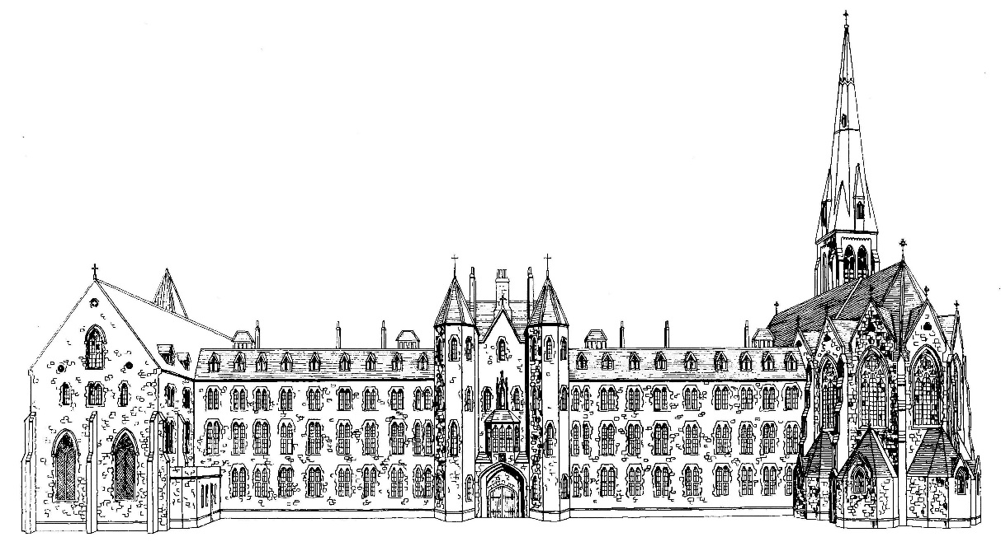
WHY CHOOSE MAYNOOTH?
Societas Liturgica 2023

Slide 4
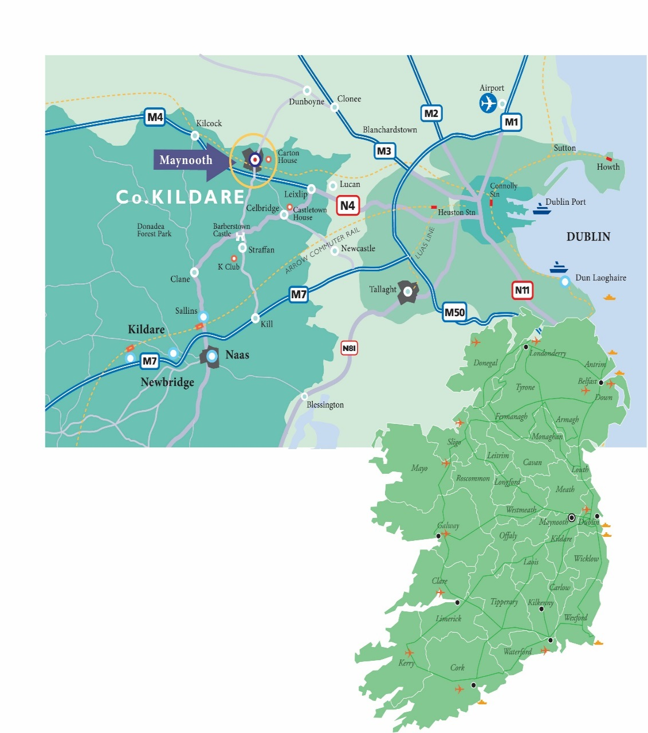
WHY CHOOSE MAYNOOTH?
LOCATION
The town of Maynooth is in north Kildare, 24km west of Dublin
33km from Dublin Airport
Dublin Airport handles 44 airlines servicing 180 destinations
Home to St Patrick’s College (founded 1795), comprising Ireland’s National Seminary and a Pontifical University. The campus is shared with Maynooth University (1997).
Societas Liturgica 2023
Notes:
The town of Maynooth is in north Kildare, 24km west of Dublin with easy access to Dublin Airport
Home to St Patrick’s College (founded 1795), comprising Ireland’s National
Seminary and a Pontifical University. The campus is shared with Maynooth University (1997).
Dublin Airport (33km from Maynooth) is a major international hub, with 44 airlines servicing 180 destinations
Excellent transport links – Airport Hopper, commuter rail and bus links to Dublin city centre, M4 motorway

Slide 5
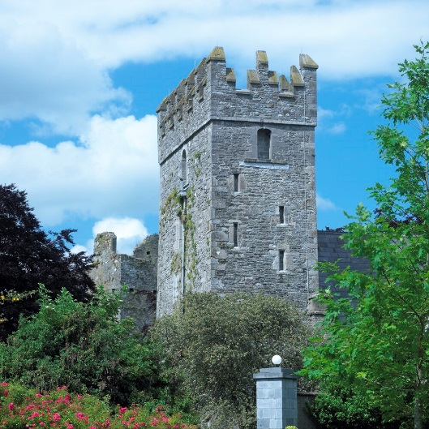
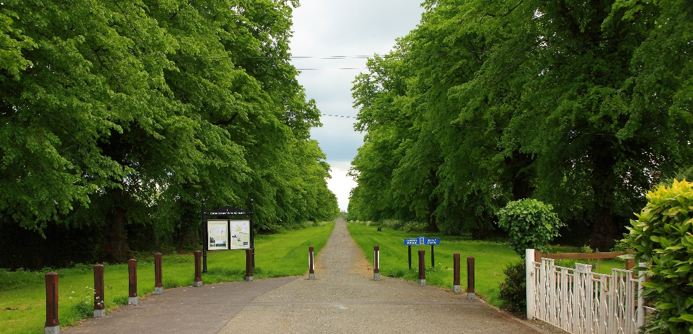
MAYNOOTH TOWN
An historic town with a choice of leisure and shopping options
Excellent transport links – Airport Hopper, commuter rail and bus links to Dublin city centre, M4 motorway
A wide range of restaurants, bars and cafes
Societas Liturgica 2023

Slide 6
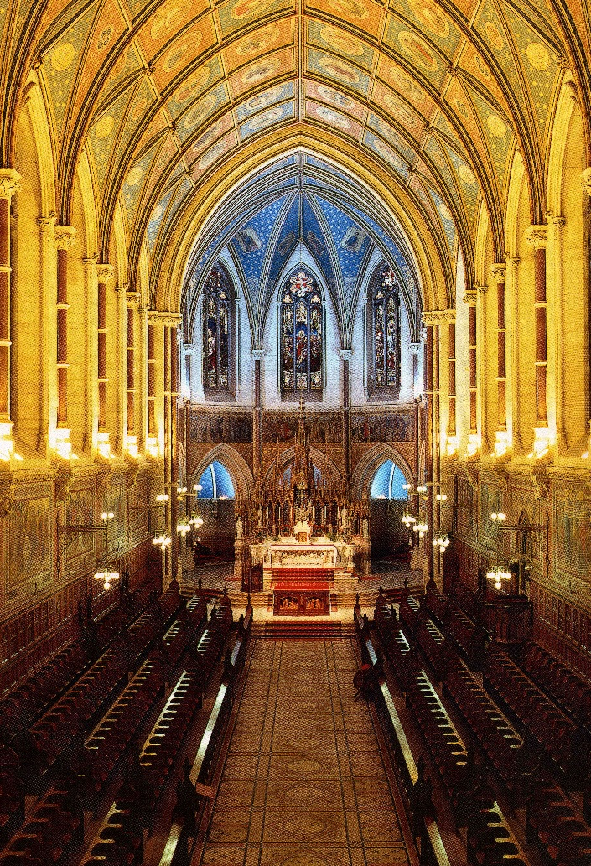
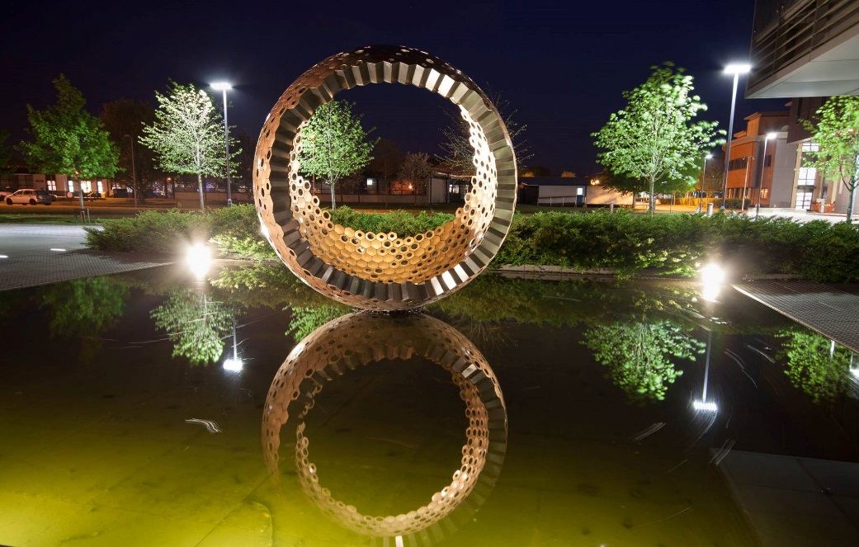
WHY CHOOSE MAYNOOTH?
THE CAMPUS
A beautiful university campus that mixes the traditional and the modern
A choice of plenary halls, breakout rooms and chapels
A wide range of en-suite and standard bedroom accommodation
Quality catering service in impressive dining-rooms
Meeting, dining and accommodation in close proximity
Societas Liturgica 2023

Slide 7
CAMPUS MAP
Societas Liturgica 2023

Slide 8
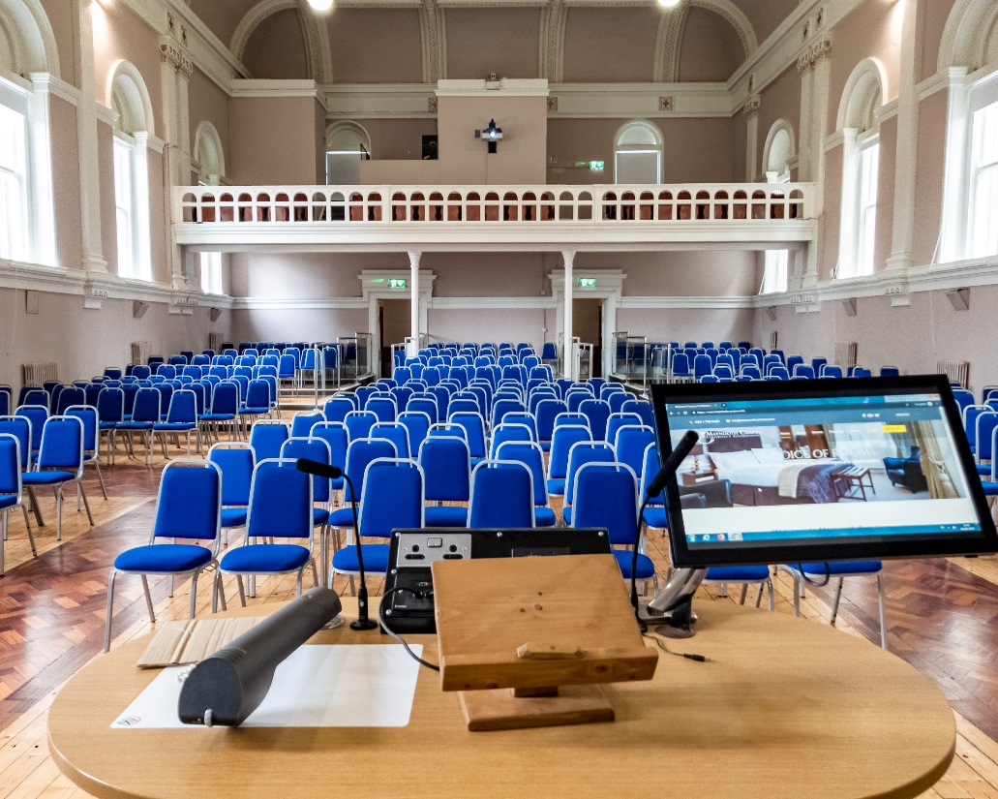
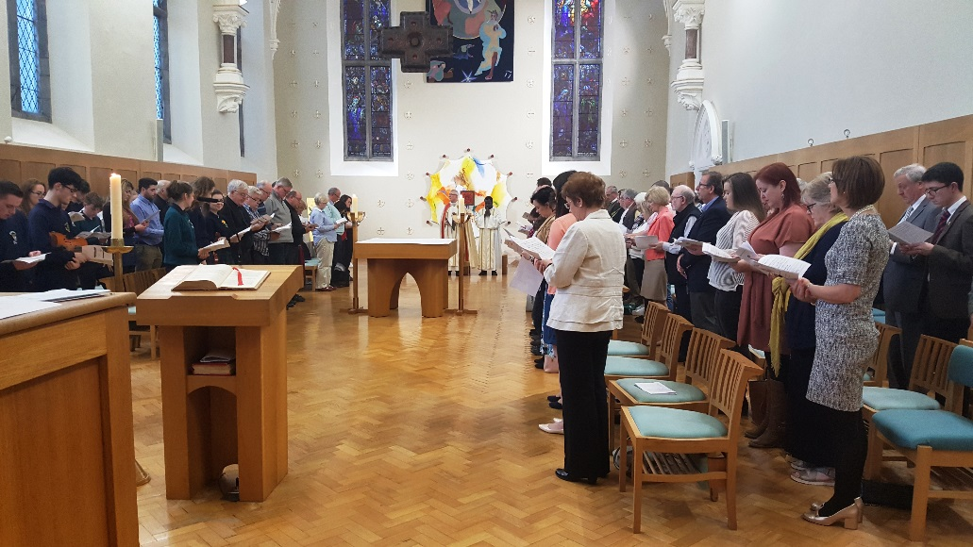
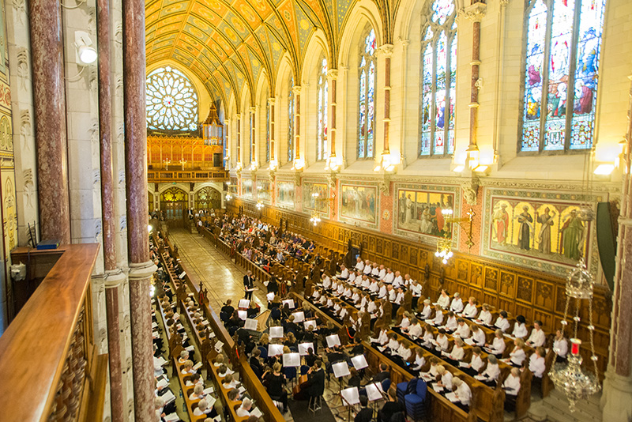
MEETING
100+ meeting spaces
Plenary & breakout rooms
College Chapel
Oratories
Gardens
Parkland walks
Societas Liturgica 2023

Slide 9
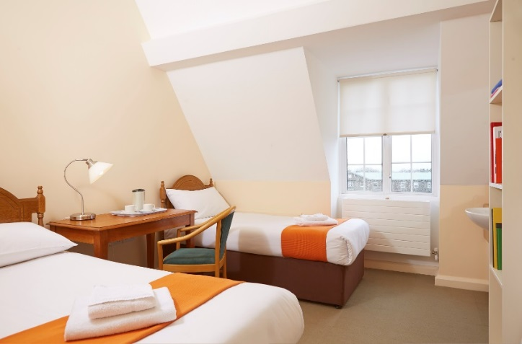
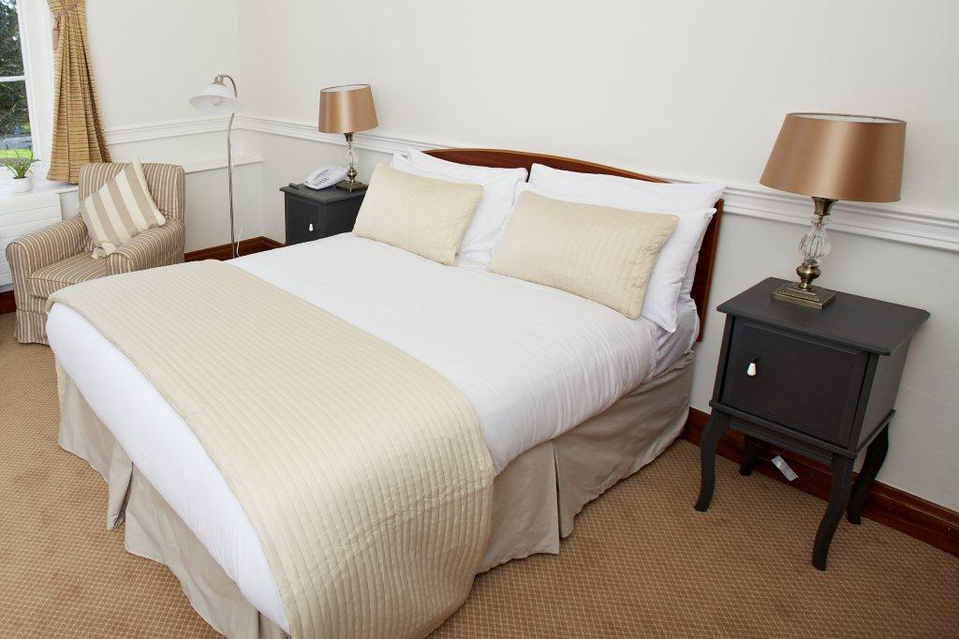
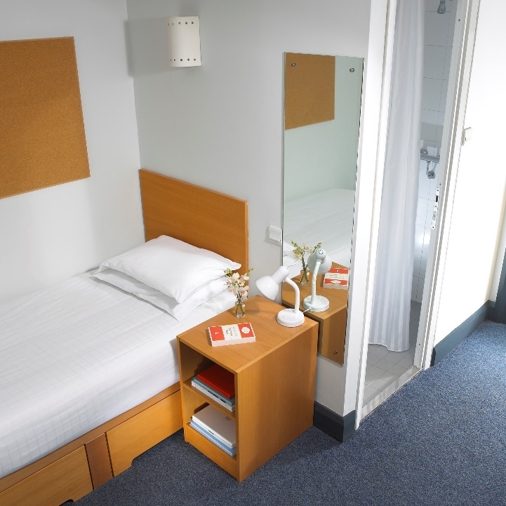
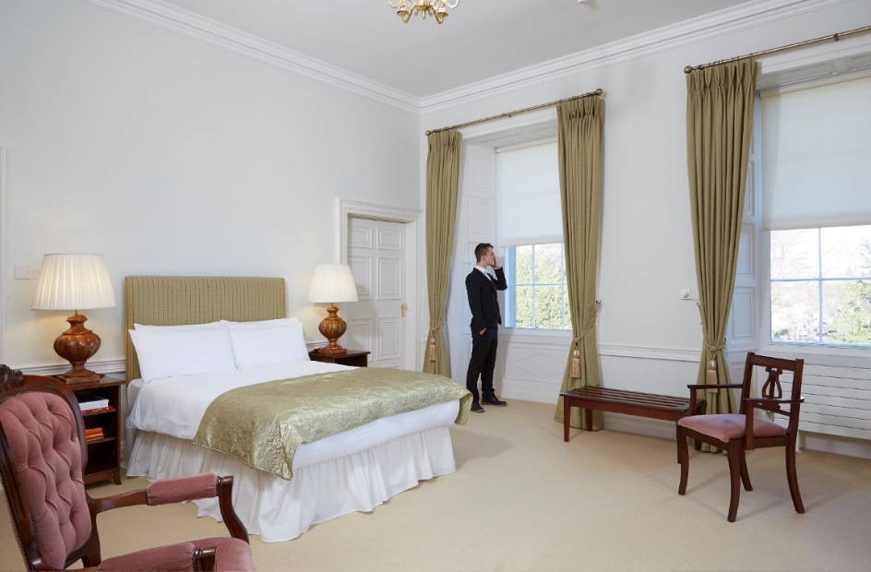
ACCOMMODATION
1,300 rooms
Range of styles & prices
Close to conference & dining facilities
Discounted rates for congress delegates
Promotional code for online booking
Societas Liturgica 2023

Slide 10
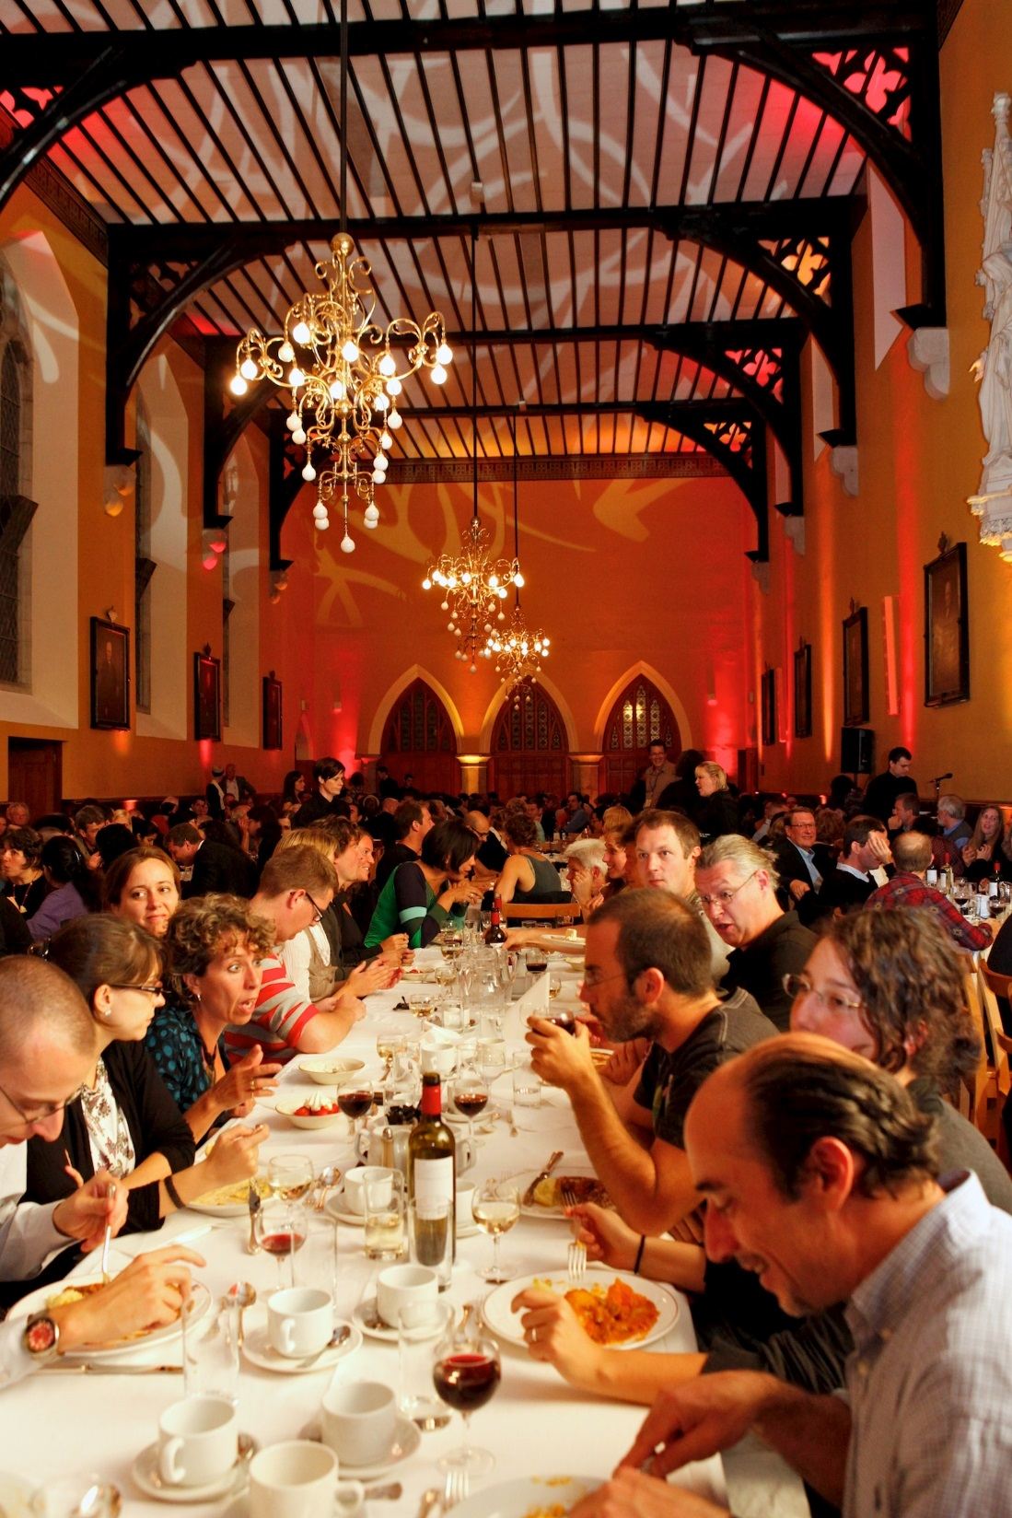
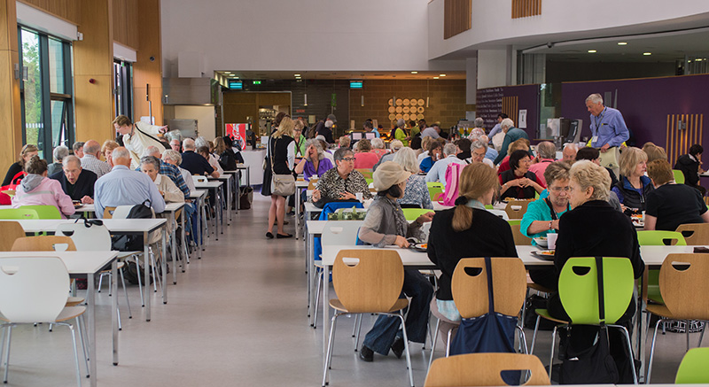
FOOD
Two main dining-rooms
Pugin Hall (seminarians’ refectory)
Self-service to silver service
Gala dinner venue
Four other on-campus food outlets
Restaurants, cafés & pubs in Maynooth town
Societas Liturgica 2023

Slide 11
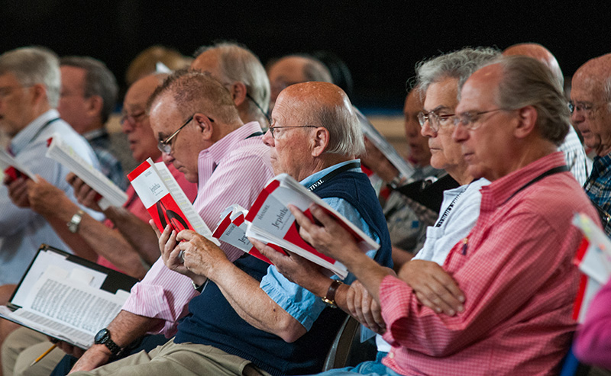
WHY CHOOSE MAYNOOTH?
A WEALTH OF EXPERIENCE
Dedicated conference service since 1991
A full spectrum of experience with conferences, retreats & major events, including Special Olympics (2003), EASA (2010), IASIL (2010), WATC (2018)
Our professional team provides expertise and assistance before, during and after the event
Active on-campus support network including
24-hour security
Maintenance
Health & Safety
Societas Liturgica 2023
Notes:
The town of Maynooth is in north Kildare, 24km west of Dublin with easy access to Dublin Airport
Home to St Patrick’s College (founded 1795), comprising Ireland’s National
Seminary and a Pontifical University. The campus is shared with Maynooth University (1997).
Dublin Airport (33km from Maynooth) is a major international hub, with 44 airlines servicing 180 destinations
Excellent transport links – Airport Hopper, commuter rail and bus links to Dublin city centre, M4 motorway

Slide 12
MAYNOOTH CAMPUS VIDEO
Societas Liturgica 2023

Slide 13
Further information
For more information about the institutions and services on the university campus at Maynooth please visit the following websites:
www.spcm.ie
www.liturgy-ireland.ie
www.maynoothcampus.com
www.maynoothuniversity.ie
Thank you for your attention
Societas Liturgica 2023

